Slide 1
GROUP PROJECT – GROUP 31
COSC 12043

Slide 2

Online Book Store

Slide 3



Purpose

Slide 4


Classes
Registration class
Login class
Book class
Orders class
Payments class
Feedback class

Slide 5

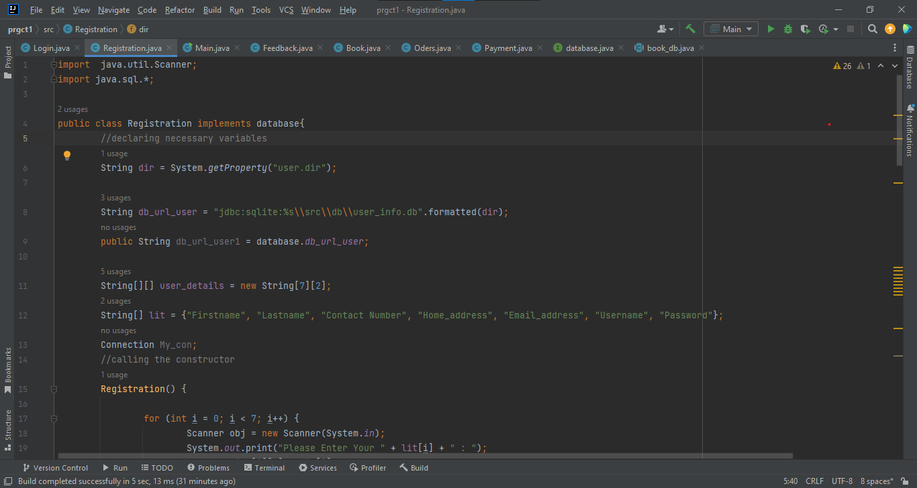
Registration class

Slide 6

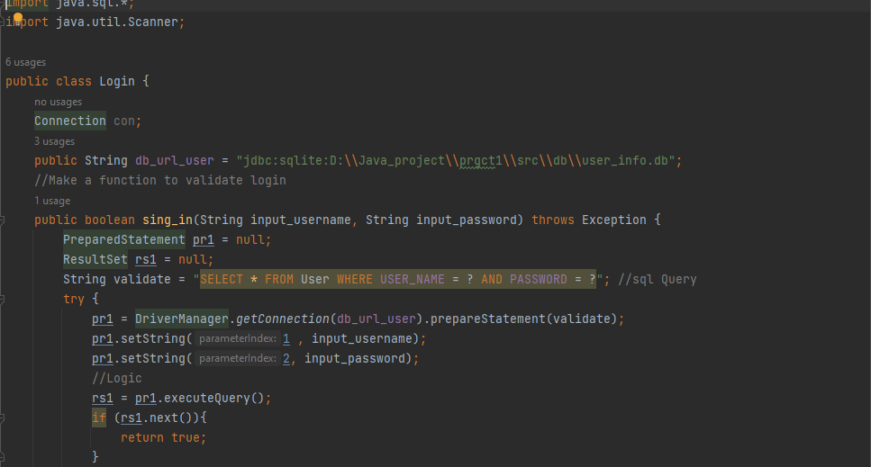
Login class

Slide 7

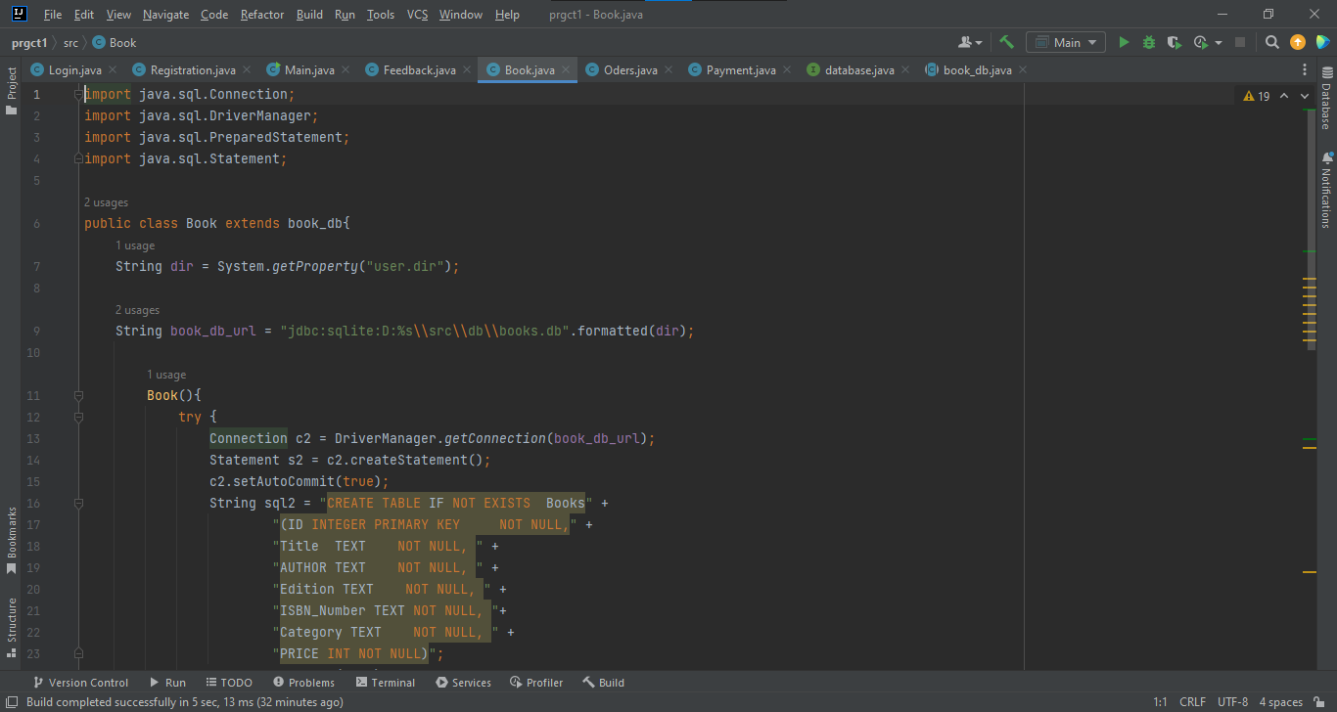
Book class

Slide 8

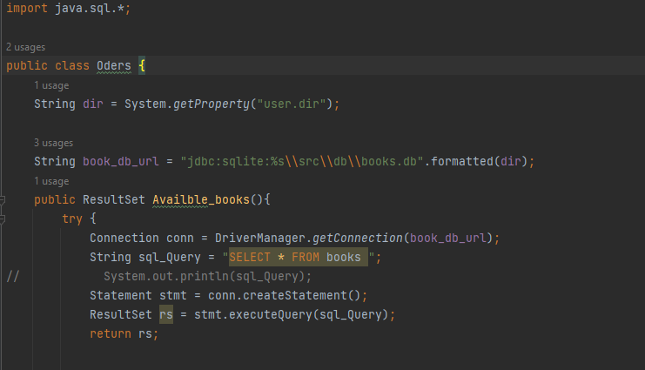
OrderS class

Slide 9
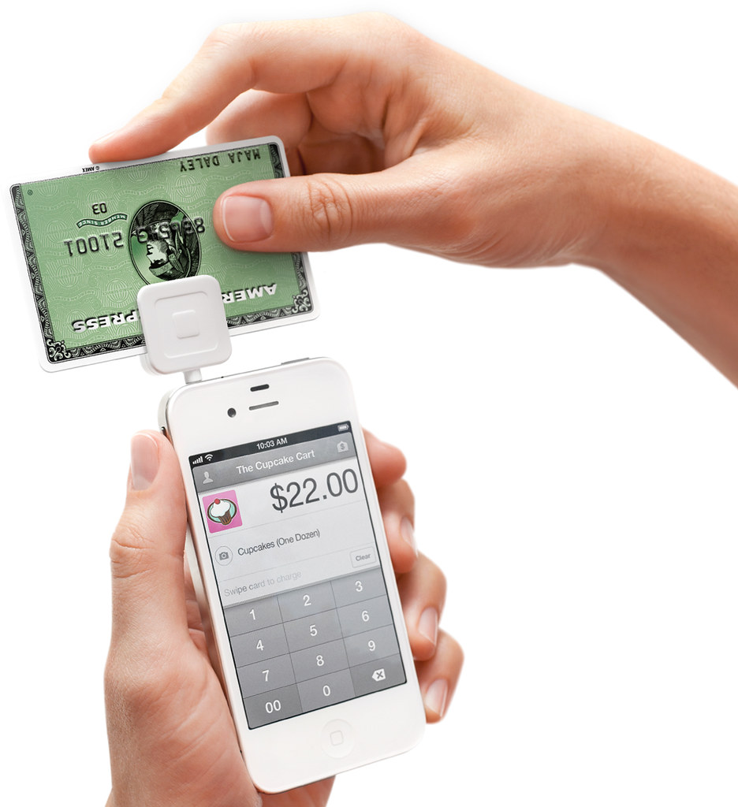
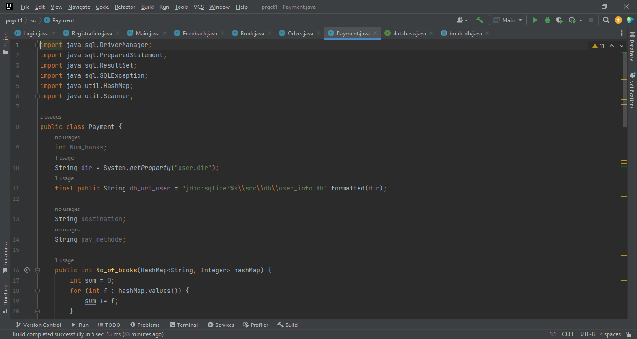
Payment class
This Photo by Unknown Author is licensed under CC BY-SA

Slide 10

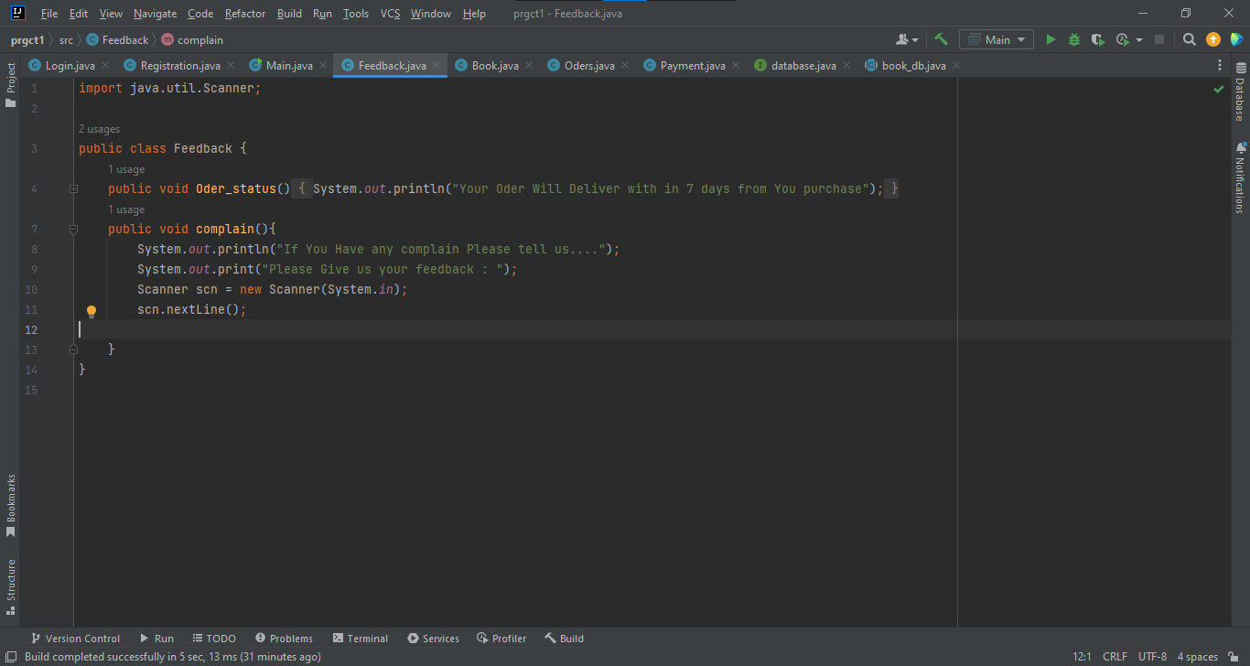
Feedback class

Slide 11
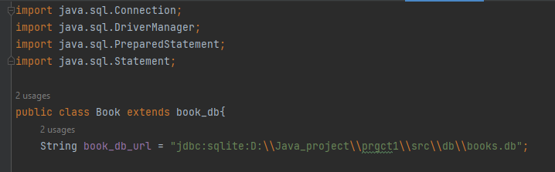
Inheritance
Extends

Slide 12
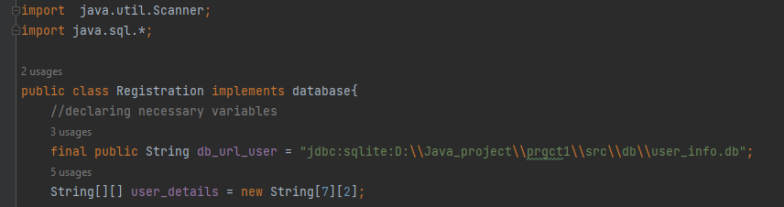
Inheritance
Implements

Slide 13
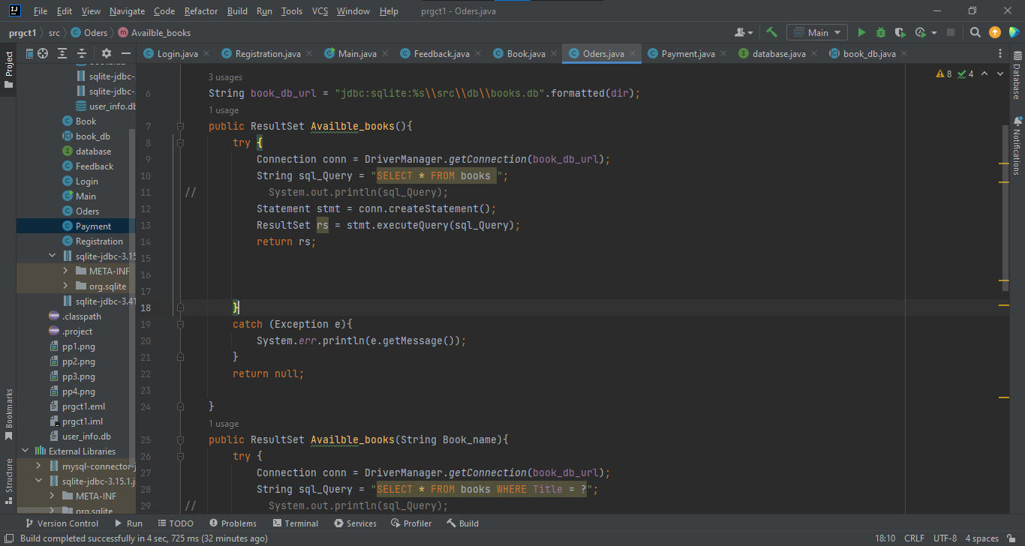
Polymorphism
Overload

Slide 14
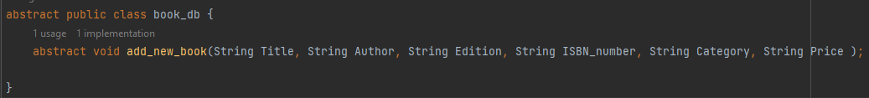
Abstraction
Abstract class

Slide 15
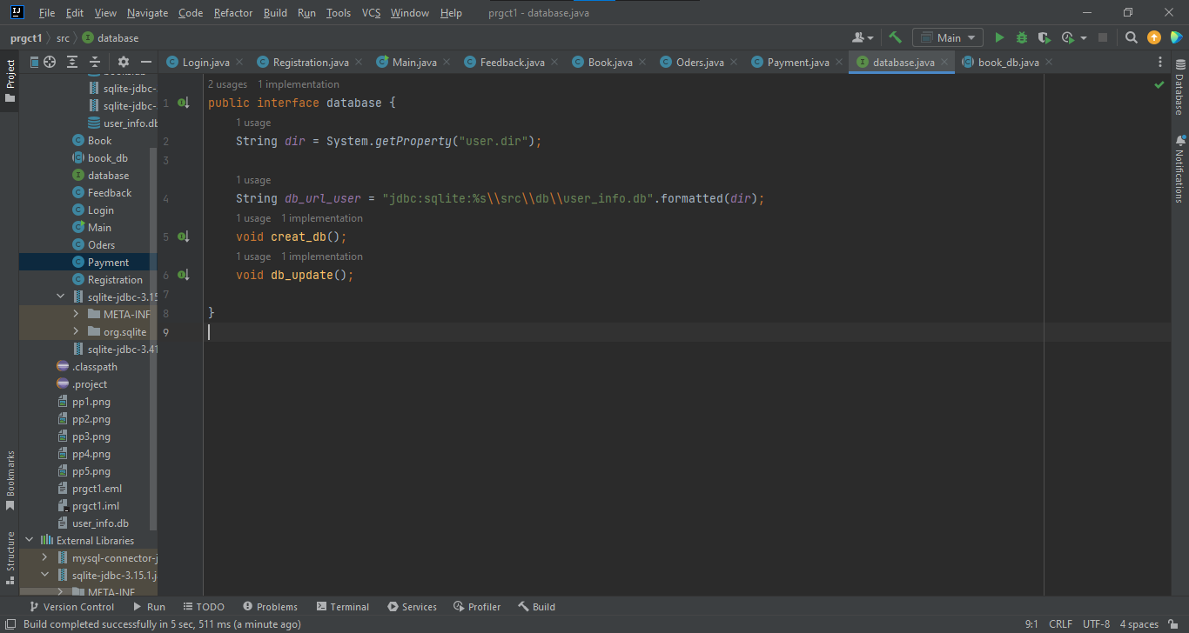
Abstraction
Interface

Slide 16

Other features

Slide 17
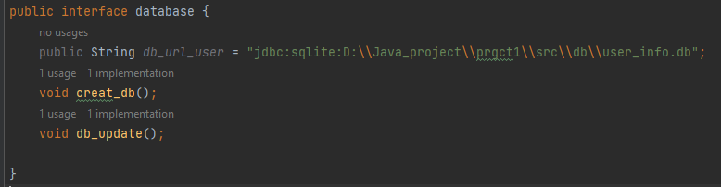
Database

Slide 18
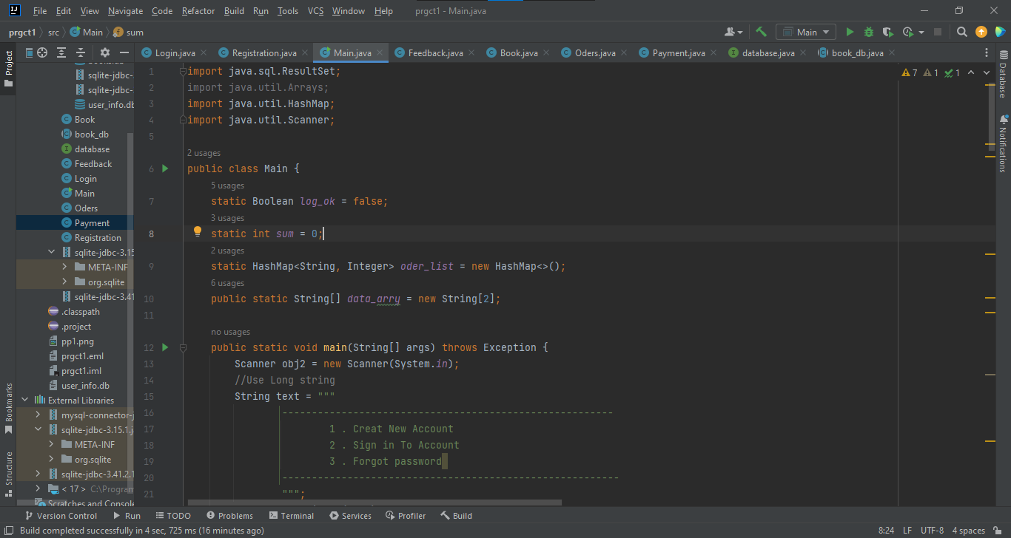
Data structure

Slide 19

Expected Features

Slide 20
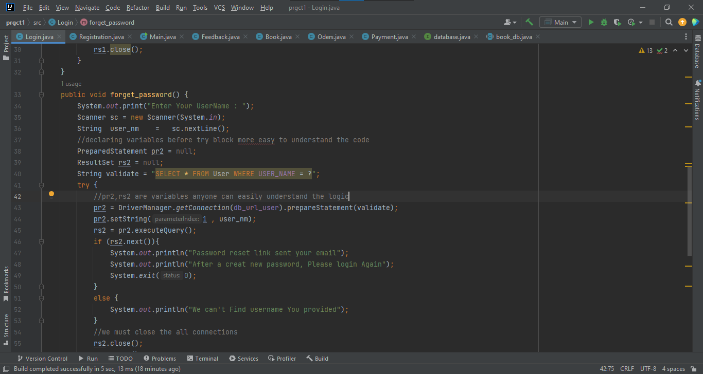

Slide 21
Web Application
Introduce to multiple sellers

Slide 22
THANK YOU !

